Slide 1
Occupational Specialist Component Content: Digital Production, Design and Development
The T Level T Level Technical Qualification in Digital: Digital Production, Design and Development includes a single Occupational Specialist Component. Therefore, there is a single synoptic assessment for the Occupational Specialist Component, which is an extended ‘design, development and implementation’ project. The synoptic element of the project is important in order to ensure that students are able to demonstrate threshold competence: this is the principal reason why the Occupational Specialism is assessed via a single extended project assessment to ensure that students are able to evidence all the skills required by the Performance Outcomes.
The T Level Technical Qualification in Digital: Digital Production, Design and Development Occupational Specialist Component consists of several activities grouped into four substantive tasks.
Each task will be completed during a window set by Pearson during which you will schedule supervised assessment sessions. In some cases, tasks will also involve opportunities for unsupervised activities where the requirements of the skills being assessed make this necessary.

Slide 2
The unit outcomes
1.5 Investigate the current and potential uses of emerging technologies and how they impact on industries
Investigate impact on software development of emerging technologies such as:
operational technology (OT)
artificial Intelligence (AI) and Virtual Intelligence (VI)
conversational AI
the Internet of Things (IoT)
machine Learning
object recognition
biometrics
computer vision
robotics
cloud services and platforms
blockchain
data lakes and data warehousing
drones
3D printing
5G networks

Slide 3
Learning Objectives
Aims:
To explore current and emerging technologies and their purposes
Objectives:
To be able to define emerging technologies which are being used today and determine where each technology falls within its lifecycle stage—innovation, growth, maturity, or decline.

Slide 4
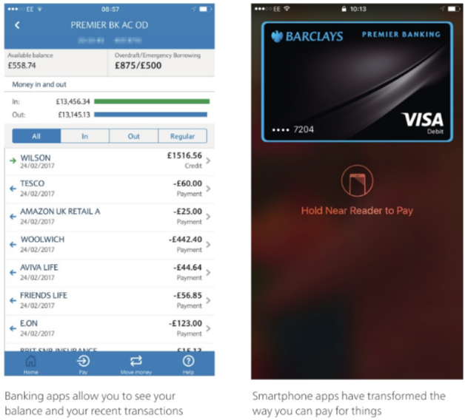
Mobile technology in different sectors
Mobile technologies have made it increasingly possible for us to connect with each other, with organisations (including employers) and with the wealth of digital information that is available online.
One of the fastest growing areas in technology development in recent years has been mobile technology.
Mobile technology is a part of everyday life and widely used in different contexts such as:
retail
banking
entertainment
social media.
For example, managing your bank account has never been easier, as shown here.

Slide 5
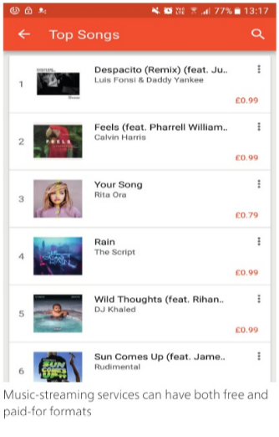
Mobile technology in different sectors
Smartphone apps such as Apple Pay® will store your card information, which can be used in shops and online to pay for goods and services.
For example, you can use Apple Pay to pay for travel on Transport for London (TfL) services (such as the London Underground, bus and rail services).
The service is activated by pressing the home button twice on an iPhone® in locked mode.
This automatically activates Apple Pay, and you can then simply follow the instructions.
You can also stream media (such as music and video for entertainment) on your device. (STREAMING is when you listen to music or you watch videos on your device without downloading them.)
If you want to use an online streaming service, you will need an internet connection.
Paying a SUBSCRIPTION (paying regularly in advance for a purchase) will provide additional services, such as better quality or access to a wider range of streamable material.
Streaming services include Spotify®, Apple Music®, Deezer™, TidalT"' and Google Play Music™.

Slide 6
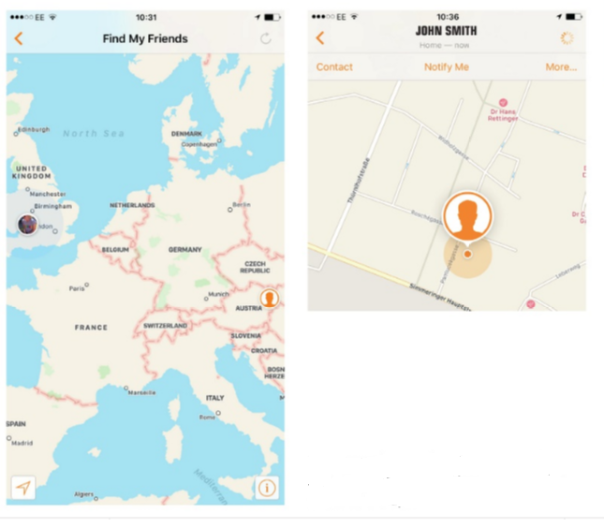
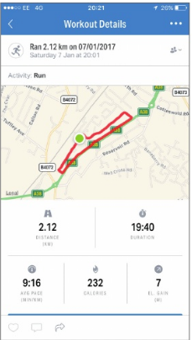
Development and use of smart devices/smartphone apps
What does the 'smart' in smartphone mean?
It means that your handheld device can now provide as much information as your PC or laptop.
In fact, it could be argued that handheld devices are even smarter than a PC or laptop as they have extra features such as location :services, which are not relevant to technology that is not mobile.
By zooming in you can see your friend at street level
Services such as Find My Friends® display the location of each of the friends that you have added to the app
Using the location services, the app will calculate the distance travelled, the time taken and the number of calories burned
Location services are also useful for tracking your progress, for example if you go for a jog or run. You can activate the app at the start of the run. You can still use other services while you run, such as listening to music.

Slide 7
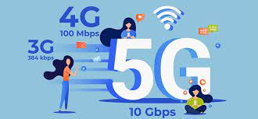
5G
5G is the fifth generation of mobile wireless communications technology — the upgrade to the 4G network.
By using shorter, higher-frequency bands of the radio spectrum, 5G promises lower latency, faster speeds, and greater load capacity.
Some researchers believe that in real-world conditions, 5G could deliver browsing and download speeds 10 to 20 times faster than the 4G network.
Ultimately, 5G promises to be a real game changer, with increased connectivity and ultra-low latency revolutionising how businesses operate.
Organisations should start looking at the technology now to see how they could use it to gain a competitive advantage.
Notes:
https://www.bytestart.co.uk/how-5g-will-benefit-businesses
https://www.telegraph.co.uk/business/5g-in-sport/what-does-5g-mean-for-businesses/

Slide 8
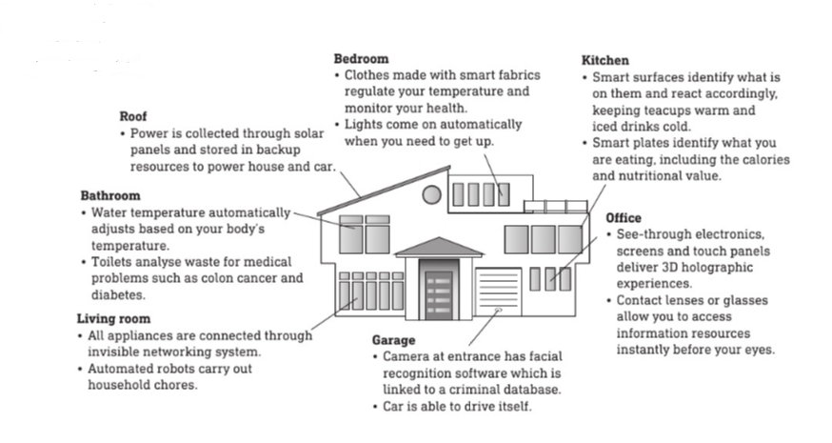
Emerging mobile technology and its future use
We cannot possibly know yet what the future may bring in terms of mobile technology developments, but we are already seeing paperless systems, as well as home and transport automation systems, being used in everyday life.
Smart home technology
The most rapidly growing area in mobile technology is currently smart home technology.
This has an infinite number of possibilities for the future, such as those shown in the image

Slide 9
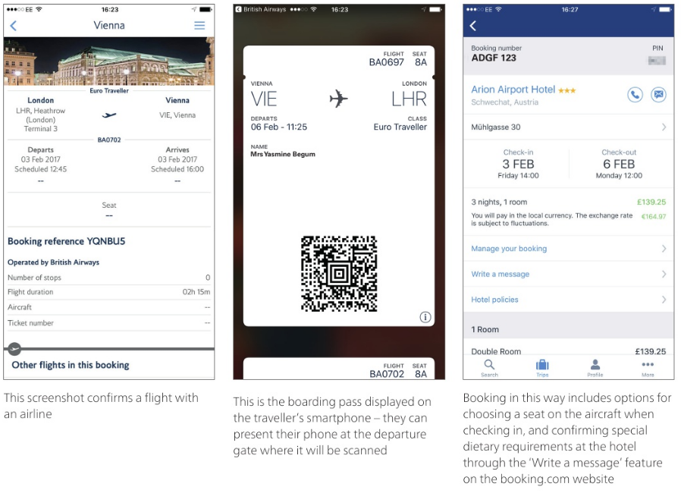
Travel
It is now possible to travel across the world with nothing more than your passport and your mobile phone.
Take a look at these images.
This traveller was able to book both a flight and a hotel online, and could also make changes using an app or visiting the main website.
Notes:
Networking and Cybersecurity
In a networking and cybersecurity role, you will often be among the first IT specialists to see and use emerging technologies, as this is where many of the innovations will occur; for example, new cabling and wireless technologies to make connectivity faster and more responsive. You will connect new devices and new technologies to existing systems and you may even build whole new systems.

Slide 10
Intelligent computer
The development of intelligent computers is creating many exciting possibilities in our working lives, as well as in domestic and leisure contexts.
However there are also potential threats to our way of life as some tasks are replaced by intelligent computers.
An intelligent computer is one that is able to do many of the tasks that are currently carried out by people.
For unpleasant or dangerous tasks, this is beneficial, but society is now asking the question:
What will happen to our jobs if more and more tasks are carried out by a computer, device or app?

Slide 11
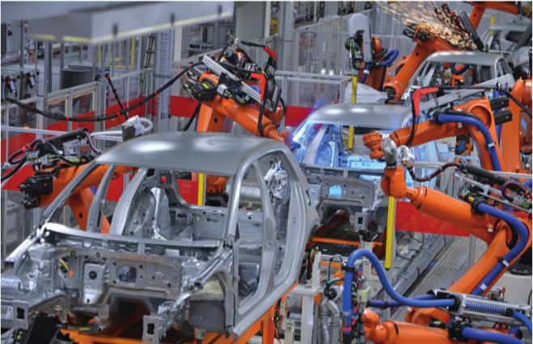
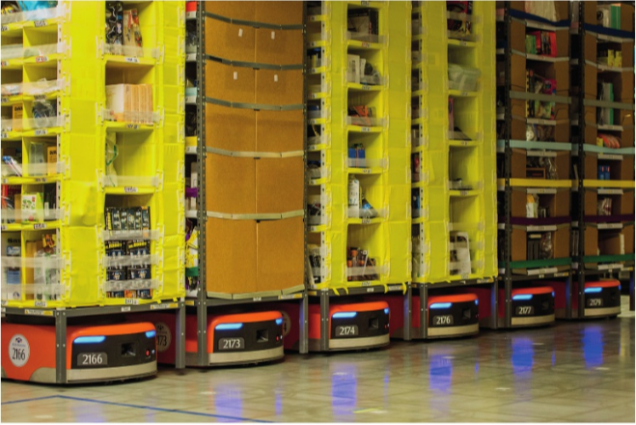
Robotics
Automating manufacturing processes using robotics is one of the first areas where using computers has been found to give real benefits.
Manufacturing processes are predictable, so using robotics is possible. Steps in the process can be programmed in advance and the technology can simply repeat the same processes over and over again.
Online retail services such as Amazon® use robotic technology to pick orders.
This means that the device moves to the location of each product in the warehouse and adds it to a basket.
Online retail services such as Amazon® use robotic technology to pick orders.
This means that the device moves to the location of each product in the warehouse and adds it to a basket.
Robots are also emerging in telehealth. This is the delivery of medical services remotely using telecommunications technology.
An example of this is the use of a robot carrying a camera, microphone and speaker, which allows a medical specialist to interact with a patient.
The camera enables the doctor to see the patient and ask questions and allows them to monitor the patient after an operation.

Slide 12
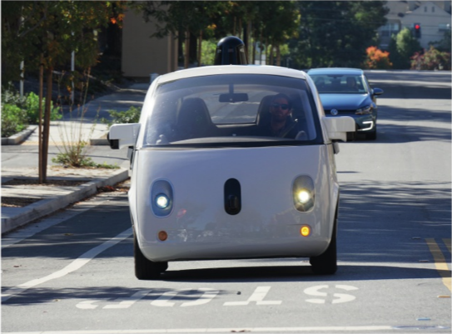
Automation
Driverless cars are already being road tested.
These rely heavily on sensor technology such as lasers, radars and cameras that are scanning in all directions and satellite navigation systems that control the position of the vehicle.
In a driverless car, the driver essentially becomes a passenger in the vehicle. These vehicles are capable of driving between destinat1ons, as well as parking - both parallel parking and bay parking.
The technology for controlling driverless transport (such as cars, buses, lorries) is already well advanced where actions are predictable.
Most of the development and testing is currently focused on creating systems that manage responses to what others do (for example, pedestrians stepping into the road, the actions of cyclists, managing poor road conditions such as snow, ice, rain, mud).
Another consideration with driverless technology is the potential lack of privacy for users, as the location of their vehicle is always being tracked.

Slide 13
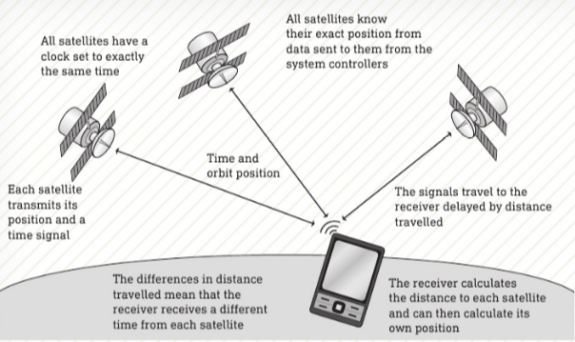
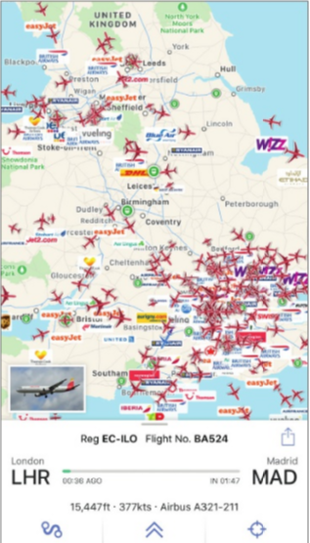
Global Positioning System (GPS)
GLOBAL POSITIONING SYSTEM (GPS) works by using the transmissions from a range of satellites to pinpoint the position of a device or object.
The image GPS relies on a number of different satellite technologies working together reliably - typically a GPS receiver needs a minimum of four satellites to establish your position accurately
The receivers in the devices or objects do not send any DATA to the satellite and, in order to work, a device needs a clear line of sight to the satellite (this means it must not be blocked by a building).
Using a combination of GPS and other location services, free apps such as Plane Finder™ display interesting information about both passenger and commercial flights. Clicking on any of the airplanes will usually display information about the flight, including:
where it flew from
where it is going
its current height
its current speed
the type of aircraft
The Plane Finder app updates in real time and you can see the aircraft moving across the screen

Slide 14
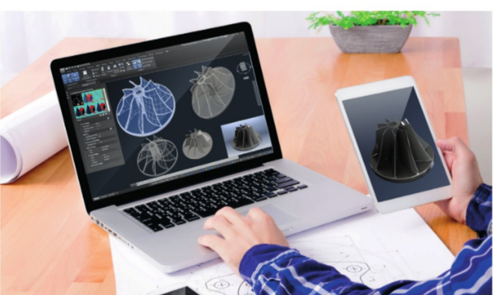
Computer-aided design (CAD)
Designing objects used to be a lengthy process requiring SCHEMATICS(technical circuits) to be drawn on paper.
Sometimes a number of engineers or designers would be working on one device or object and someone had to update a master drawing whenever changes were made.
CAD software has revolutionised design and, with collaborative versions of the software, multiple users can work on the same diagram in real time.
If the software is also linked to simulation software, the designs can be tested and, in some cases, prototypes can be printed using 3D printing technology

Slide 15
Voice control
There are many different ways that voice control is used in relation to technology.
One of the most recent is the Amazon Echo® with its Alexa Voice Service, which uses voice commands to provide a range of services.
Once set up, this device can control lights, switches and heating and can make diary entries, play music, provide food recipes, play the news, transmit audio content such as audio books and allow you to order takeaway food through services such as Just Eat®.
There is a variation of this on the iPhone called Siri® and another version on Windows® phones called Cortana®.
Siri will carry out a whole range of tasks, including:
scheduling reminders
opening and closing apps
reading your messages or emails to you
searching for phone and internet content
navigating with features such as 'take me home'
texting or calling hands free
setting a timer
setting alarms
checking the weather
solving maths problems
checking voicemails

Slide 16
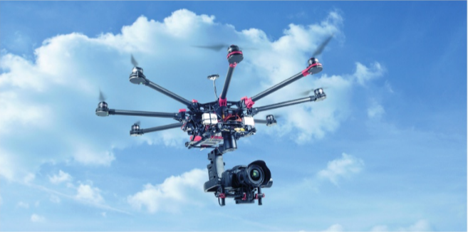
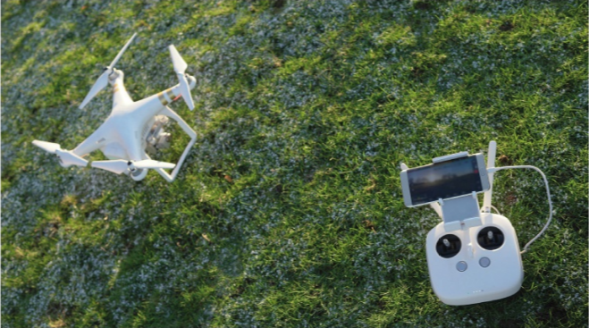
Use of drones
A DRONE is an unmanned aerial vehicle (UAV).
They come in many shapes and sizes and are being increasingly used in different ways (see Table).
It is clear that drones can be used by organisations in many different ways.
For this reason, they also come in a variety of shapes and sizes and with a range of accessories as shown in the photograph.
Why do drones need to come in different shapes and sizes?
The smallest camera drone currently on the market is 4.3 cm wide and has a fully working camera.

Slide 17
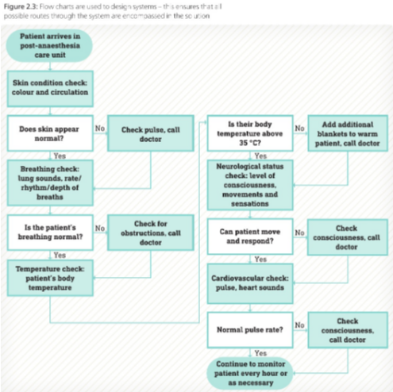
Artificial intelligence
New uses for artificial intelligence (Al) are being found every day, especially in areas such as medical diagnostics and fraud detection, making the processes much quicker and more effective.
Medical diagnosis
ARTIFICIAL INTELLIGENCE (AI) SYSTEMS are different from most computer solutions because they can make decisions and also be programmed to learn.
It is not uncommon for computers to be used in medical diagnosis.
For example, the Accident and Emergency departments at most hospitals run a triage service.
This involves making some initial checks on the patient and then taking appropriate action.
Using an Al system means that this initial screening can be undertaken by someone less qualified than a doctor.
A qualified nurse will use the system to make an initial diagnosis by asking a series of yes/no questions that have a predictable outcome (see image).
At any stage, a doctor can intervene.

Slide 18
Artificial intelligence
One of the advantages of using an Al system is that it is unlikely that factors will be missed because the process to make all the checks has been set out in advance.
It also benefits from the lack of emotion or personal connection to the patient, which means that the medical staff remain more objective.
However, this could mean that other symptoms might get overlooked, which is why currently Al systems are not used where life or death decisions may need to be made.

Slide 19
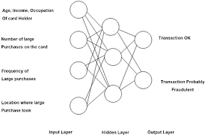
Finance
Another example of the application of Al is in neural network fraud detection. These systems use a range of information to identify unusual or suspicious activity that might be a sign of fraud.
For example, if the profiles of card and account holders- how old you are, where you live and the amount of money you typically spend on technology- make the sudden purchase of new TVs, computers, laptops and devices unusual, this would trigger concern.
Profile and account information is combined with historical information about what tends to happen to lost or stolen cards, applications for credit and mail order accounts.
Once this is in place, the software monitors activity and looks for common patterns that might indicate fraudulent activity.
The system then sends alerts so that activity can be investigated.

Slide 20
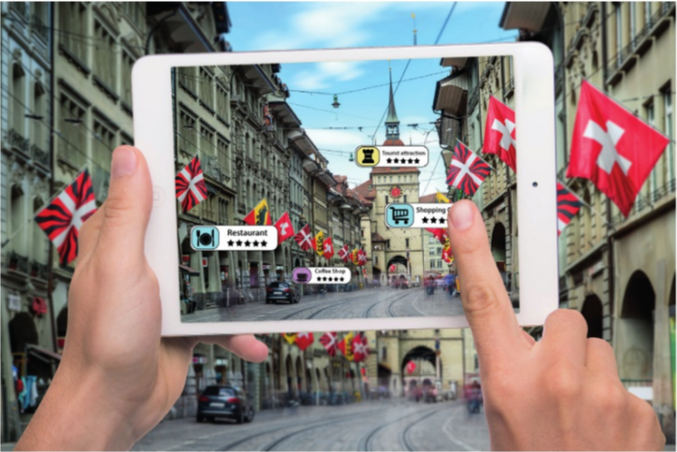
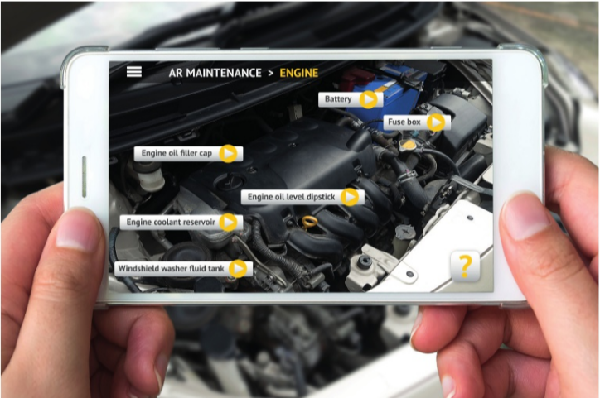
Augmented reality (AR)
AUGMENTED REALITY (AR) is a technology that is used to overlay an image that has been generated by a computer onto what the user can see in the real world, providing a merged view.
Notes:
Augmented reality (AR)
AUGMENTED REALITY (AR) is a technology that is used to overlay an image that has been generated by a computer onto what the user can see in the real world, providing a merged view.
Image - An app being used in conjunction with a real view
Table 2.3 gives other examples of how organisations might use augmented reality.
Overlaying diagrams of car parts on to a captured image of an engine can help to teach basic car maintenance

Slide 21
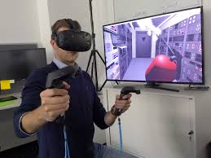
Virtual reality (VR)
VIRTUAL REALITY (VR is a computer-generated simulation that people can interact with in a physical way.
It involves using a headset but can also include gloves fitted with sensors. Table 2.4 shows some uses of virtual reality.

Slide 22


Use of social media
Organisations and businesses use social media in different ways to promote themselves and their services.
For example, they might use Facebook® pages, Twitter feeds and YouTube ™ channels.
BLOGS and VLOGS are also a part of the social media landscape.
Blogs (short for weblog) are similar to a journal or diary written by an individual and made public for anyone to read;
vlogs are weblogs that are largely made up of videos.
A VLOGGER is a person who owns, runs or contributes to a vlog.
They build up subscribers, and the more subscribers a vlog has, the more successful it is considered to be.

Slide 23
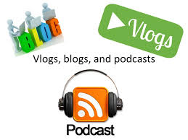
Use of social media
In February 2017, some of the most popular UK vlogs were:
TheDiamondMinecart - 14 million subscribers
KSI - 15 million subscribers
Caspar - 7 million subscribers
ThatcherJoe - 7 million subscribers
These vlogs include prankster, comedy and gaming content. They are attractive to businesses for the following two reasons.
If vloggers have a large number of subscribers, then businesseswill target advertising that would interest a subscriber of that particular type of vlog. The business pays the vlogger to display their advertisements.
Some vloggers become very well known and, as social media celebrities, any products they endorse should result in more sales.
Some vloggers are so successful that they earn their living from their vlog

Slide 24
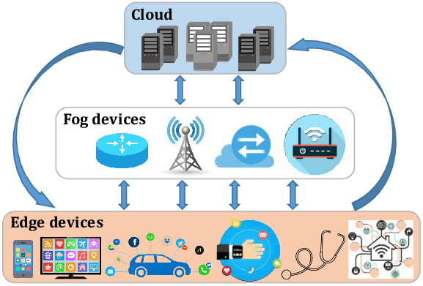
Internet of Things (loT)
The INTERNET OF THINGS (IoT) is a term which groups together all technologies that have internet connectivity.
This includes household devices, smartphones and smartwatches, tablets, and location devices.
Connecting devices over the internet
The IT and computing industry ,generally agree that by 2020, there will be more than 30 billion devices connected to the internet.
This will include significantly more handheld devices, such as phones and tablets, but is also likely to include an increasing number of devices in the home and both personal and public forms of transport.
It is not possible to know what other technologies will be attached to the internet because these devices are currently in development.

Slide 25
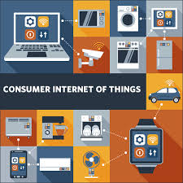
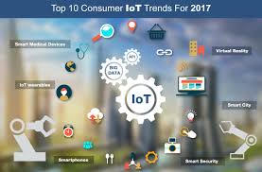
IoT - Consumers
Consumers are becoming increasingly aware of the possibilities associated with the loT and are finding more and more ways of using technology in their day-to-day activities.
Using smartphones and new smart fridge technology, the system monitors the food products in your fridge (including what you have, how much and the use-by dates). You use the app to decide what to eat (because it identifies what needs to be used first), and you can use the same app in the supermarket to buy products you are running low on.
Hive®, Nest® and tado0 systems control the heating in your home and allow you to switch your home systems on and off, and change the temperature.
The next step is a home automation system such as Wink Hub 2™ or Logitech Harmony Elite that also controls the lighting and the locks in your home and can have surveillance functionality in various forms. The system can tell you when the members. of the household leave and return to the home.

Slide 26
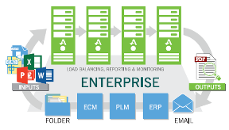
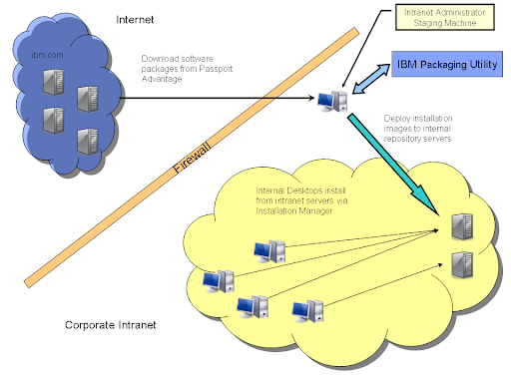
Enterprise deployments
ENTERPRISE DEPLOYMENTS are basic versions of software that have added functionality.
They are designed for business use (rather than for an individual user).
Two key factors that are considered when creating enterprise versions are additional security and SCALABILITY (this means that the software can support more users as necessary).
Enterprise systems are often made up of a large number of PCs and servers, with a wide range of connected devices.
Online connectivity - Connected devices that are not using a free Wi-Fi connection will be subject to data charges.

Slide 27
Enabling technologies
There are three key communications technologies that make the loT possible that are heavily used in different contexts.
These technologies are BLUETOOTH, RADIO FREQUENCY IDENTIFICATION (RFID) and NEAR FIELD COMMUNICATION (NFC)

Slide 28
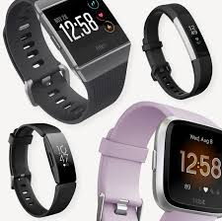
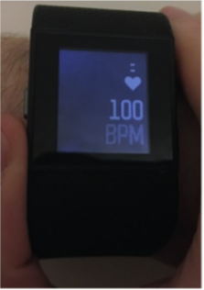
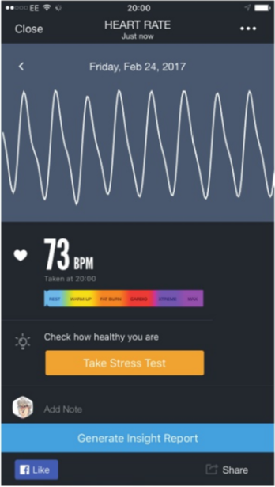
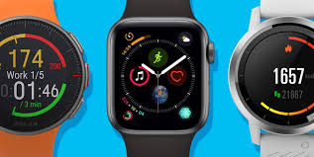
Development of wearable technology
One of the biggest growth markets currently is wearable technology, from the smartwatch to smart glasses and devices such as Fitbit® that are used in sport.
Fitbit - Data can be uploaded to Fitbit software that you can use to monitor your own health over a period of time. Fitbit uses sensors on the back of a watch to monitor a range of factors, such as your activity, your heart rate and your sleep patterns.
Smartwatches - An alternative is using an app such as Heart Rate on a smartwatch. To get a reading, you simply hold your index finger flat over the camera for approximately 10 seconds. Readings are stored in the app and allow you to build up a picture of your heart health over time and when you are in different states, such as duriinq an exercise warm up or cardio session.

Slide 29
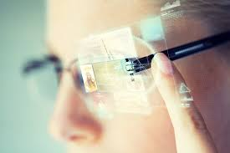
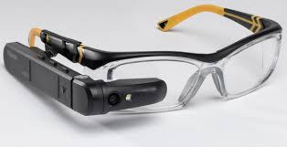
Smart glasses
Using augmented reality technology, smart glasses are a wearable technology that overlays what you can see with computer-generated information.
For example, you could be wearing the glasses while walking through London and text or images would appear beside buildings, statues or other features you are looking at, telling you something about them.
This technology is already being used in some museums as an alternative to tour guides.
The advantage is that, in addition to not having to employ someone to show you around, this technology means that users can walk through the museum at their own pace.
It also allows the information to be delivered to the user in their native language.

Slide 30
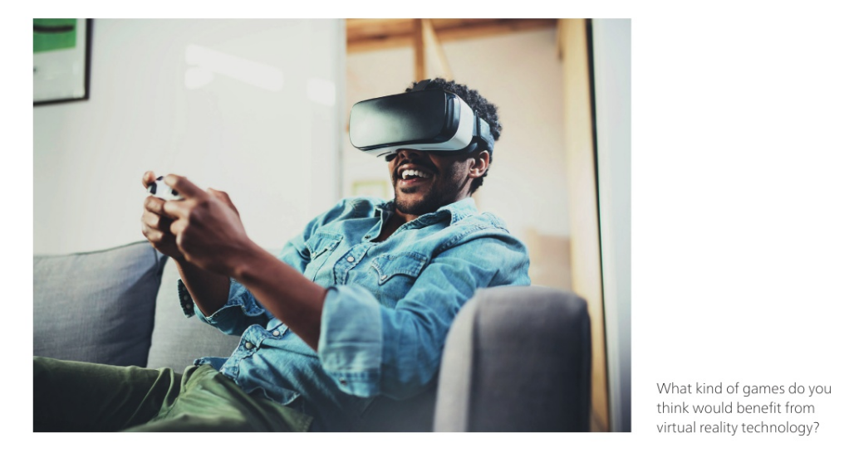
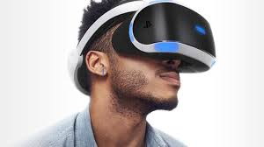
Goggles
Goggles that make use of virtual reality technology are used to enhance the wearer's gaming experience, or can be used in a range of training or therapeutic contexts such as teaching firefighters to cope in a house fire.
Where previous training has relied on the use of real smoke-filled constructions, most of these effects can now be achieved through the use of VR goggles.

Slide 31

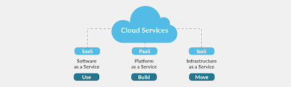
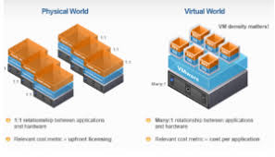
Cloud technology
Historically, organisations were responsible for their entire IT systems and all the functionality that was needed by the organisation.
This was called LEGACY IT.
The emergence of CLOUD TECHNOLOGY has made it possible for IT services to make use of computing resources that are not physically present at the organisation's office.
They are remote services that are accessed via the internet.
As there is no physical box on site, this reduces the amount of money that the organisation has tied up in technology.
In addlition, the business does not need to worry about maintenance and any faults are usually handled by the service provider.
The servers tend to be a combination of physical and/or VIRTUALISED SERVERS.
A virtualised server is simply a server where storage has been split into different parts and each one behaves like a server in its own right.
It is a physical server of virtual servers.

Slide 32
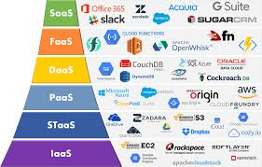
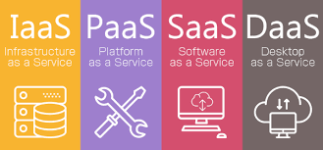
Cloud technology
Cloud servers tend to exist in larger data centres and warehouses so the physical conditions, the environment, the backup and the security are typically very good.
Even if the organisation is using cloud services, it should still continue to make occasional backups.
These will usually be scheduled automatically at off-peak times (when the organisation is closed, such as overnight).
Cloud services can be split into four separate cloud technologies.
Software as a service (Saas)
Infrastructure as a service (laas)
Platform as a service (Paas)
Data as a service (Daas)
Each service provides different functionality and each is used for different purposes by different types of people.
Some solutions that a company might use may involve more than one simultaneously, much in the same way as a car relies on petrol, electricity, coolant, air and so on to work properly.

Slide 33
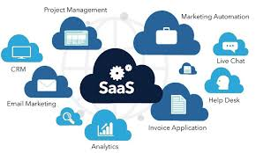
Software as a service (Saas)
This is a cloud-based application service, which replaces the more traditional installed software with applications that are provided by the service provider.
These are used via an internet BROWSER (for example, web-based applications to create spreadsheets, word-process, complete online forms such as tax, interact with a customer relationship management database).
A third party sells the organization a license that enables it to use applications it would previously have had to buy and install on its own machines.
Advantages of Saas are that:
it is always up to date
no installations or patches are needed on individual machines in the office
technical support needs are reduced
staff always use the same version of the application so there will be no incompatibility issues with files
it can be used outside office hours and outside the office itself
users will normally be able to collaborate online. Commercial examples of the uses of Saas include:
Google apps for Work™ (also known as G Suite™)
Draw.io™ for creating flowcharts and diagrams online.

Slide 34
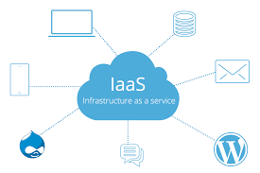
Infrastructure as a service (Iaas)
This service focuses more on the organisation's hardware.
For example, the organisation will not purchase physical servers and machines, but will instead use cloud-based hardware and virtualised instances as its base platform.
This means that a remote 'box' provides arn OPERATING SYSTEM (often Linux™ but MS® Windows Servers™ also exist).
laas can be referred to as consumption based: the organisation can use the services in much the same way as it uses electricity.
It pays for the amount of data it stores and the central processing or RANDOM-ACCESS MEMORY (RAM) it uses on an ongoing basis.
One of the main advantages is its scalability.
The main benefit of this type of service is that the organisation no longer has to worry about the hardware and networking equipment as this is managed by the service provider, which also manages and maintains the servers.
Commercial examples of the uses of laas include:
Amazon Web Services®
Microsoft<t Azure™
Google Compute Engine™

Slide 35
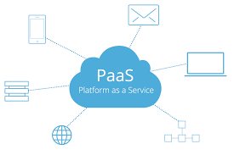
Platform as a service (Paas)
This approach is often used in software development because it allows the programmers to work at a higher level with less complexity.
It can be useful where multiple developers are working together on a single project.
The hardware infrastructure is provided and the development applications are managed by the organisation.
Commercial examples of Paas include:
Open PaaS
Mobile PaaS
PaaS for Rapid Development.

Slide 36

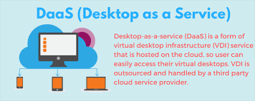
Data as a service (Daas)
In traditional systems, the format and structure of data was linked closely with the application that created and managed it.
This meant that any changes in data or processing would affect each other.
This required the code or the data to be restructured to keep everything working.
Daas involves separating the two and having data provided in a neutral way that multiple applications can 'talk' to.
Then, even if the application changes, it can use methods that translate the data sources so that they can be used.
Examples of data that could be used include:
population data
statistics
consumer data.

Slide 37
Lifecycle Stages
Emerging technologies follow a typical lifecycle path that helps assess their current state in the market and potential future development:
Innovation: New or experimental technologies with limited adoption and high uncertainty.
Growth: Rapidly developing technologies gaining traction in industries with increasing adoption.
Maturity: Well-established technologies widely used across sectors with slower innovation.
Decline: Outdated or replaced technologies experiencing reduced relevance and adoption.
Two common models used to identify these stages include:
Technology Adoption Lifecycle – categorizes users by adoption behaviour: Innovators, Early Adopters, Early Majority, Late Majority, and Laggards.
Gartner Hype Cycle – tracks the visibility and maturity of a technology through five phases: Innovation Trigger, Peak of Inflated Expectations, Trough of Disillusionment, Slope of Enlightenment, and Plateau of Productivity.

Slide 38
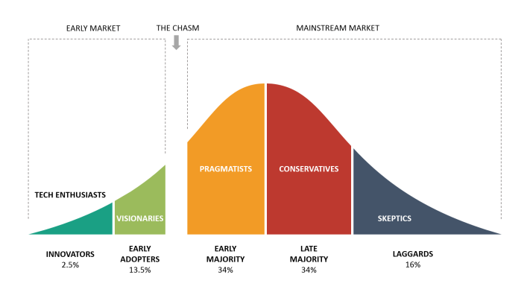
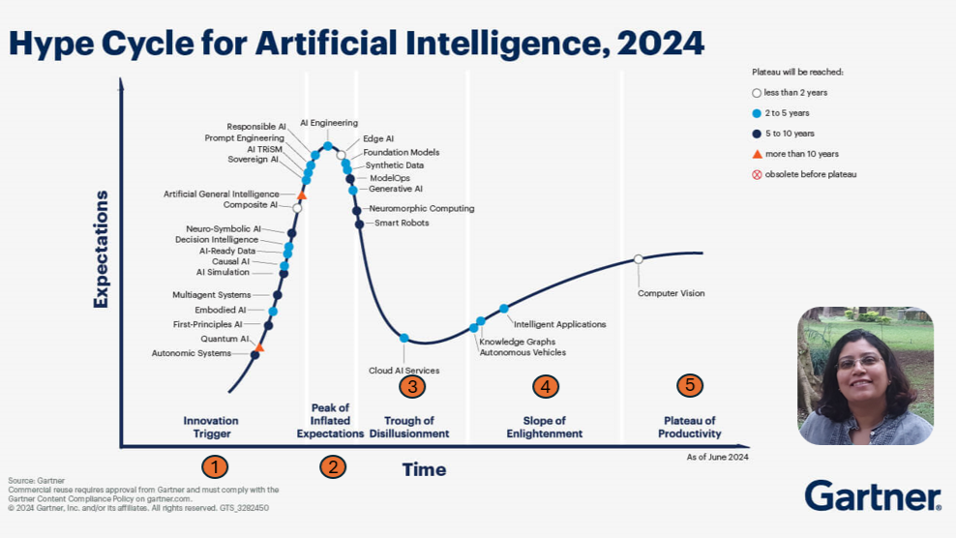
Analyse Technology Maturity
Technology Adoption Lifecycle:
Explains how users adopt technology over time:
Innovators – first to try new tech
Early Adopters – opinion leaders and trendsetters
Early Majority – practical users adopting after proven success
Late Majority – sceptical users adopting out of necessity
Laggards – last to adopt, often due to resistance to change
Gartner Hype Cycle:
Tracks the visibility and maturity of a technology across five phases:
Innovation Trigger – breakthrough ideas begin
Peak of Inflated Expectations – hype grows, unrealistic expectations
Trough of Disillusionment – disappointment as reality sets in
Slope of Enlightenment – practical applications emerge
Plateau of Productivity – widespread and sustainable adoption
Notes:
https://www.linkedin.com/pulse/ai-adoption-lifecycle-lawrence-ip-lql8c
https://www.gartner.com/en/articles/hype-cycle-for-artificial-intelligence

Slide 39
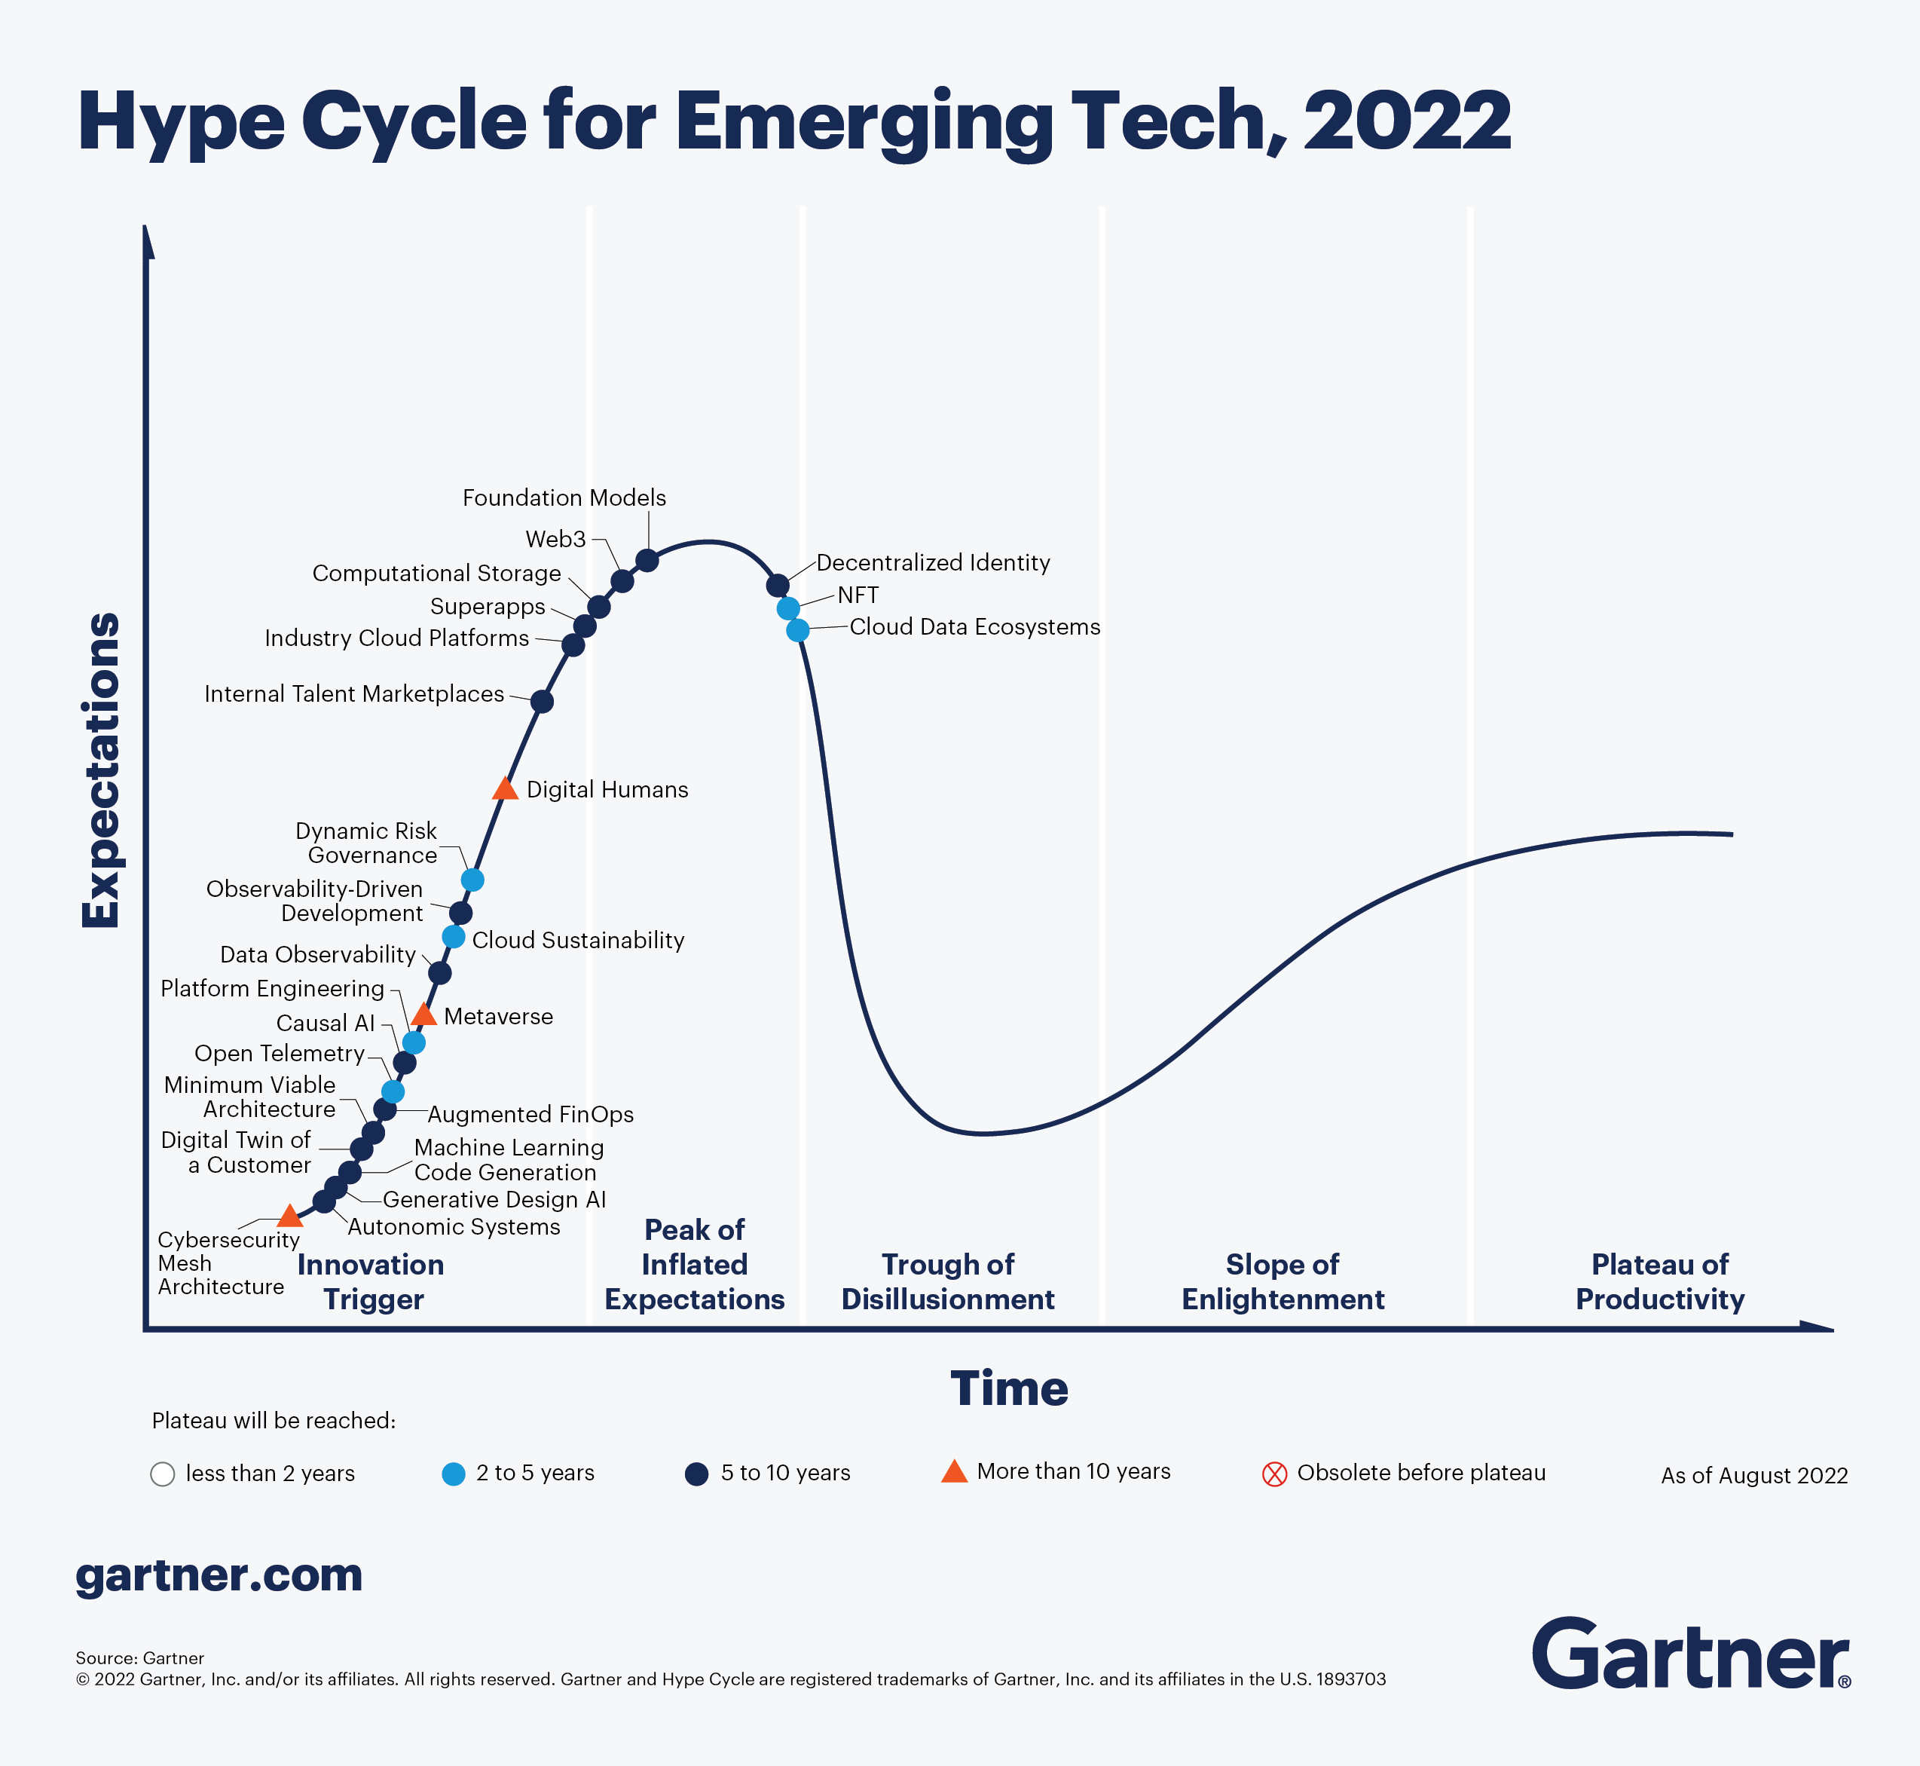
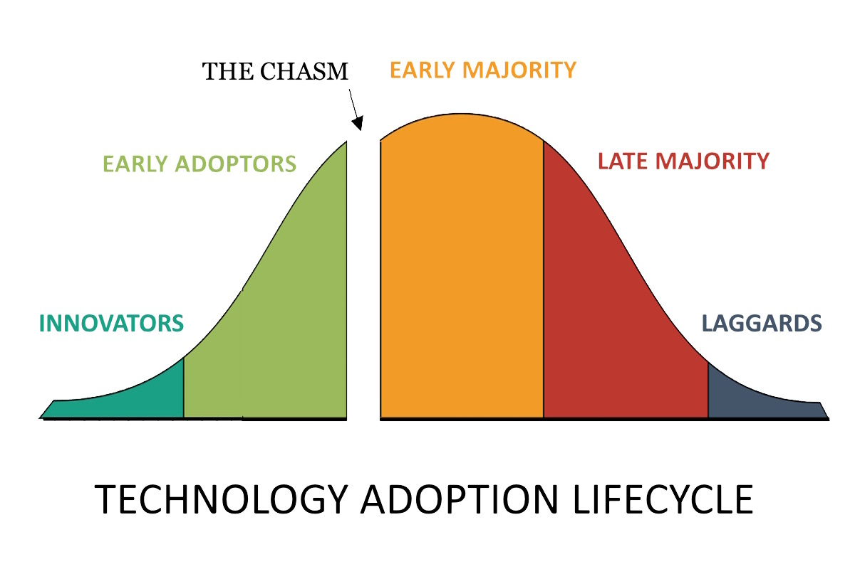
Activity - Investigating Emerging Technologies lifecycles
Objective: Explore how emerging technologies are used today and where they are on their lifecycle (innovation, growth, maturity, or decline).
Team Goals:
Research 5 emerging technologies
Analyse real-world applications
Identify lifecycle stages
Present findings in a collaborative report and presentation
Key Lifecycle Models:
Technology Adoption Lifecycle
Gartner Hype Cycle
Outcome:
Understand the maturity and industry relevance of each technology.
Notes:
https://www.business-reporter.co.uk/improving-business-performance/using-the-technology-adoption-lifecycle-to-overcome-blocks
https://www.gartner.com/en/articles/what-s-new-in-the-2022-gartner-hype-cycle-for-emerging-technologies
https://www.gartner.com/en/articles/top-technology-trends-2025

